Slide 1
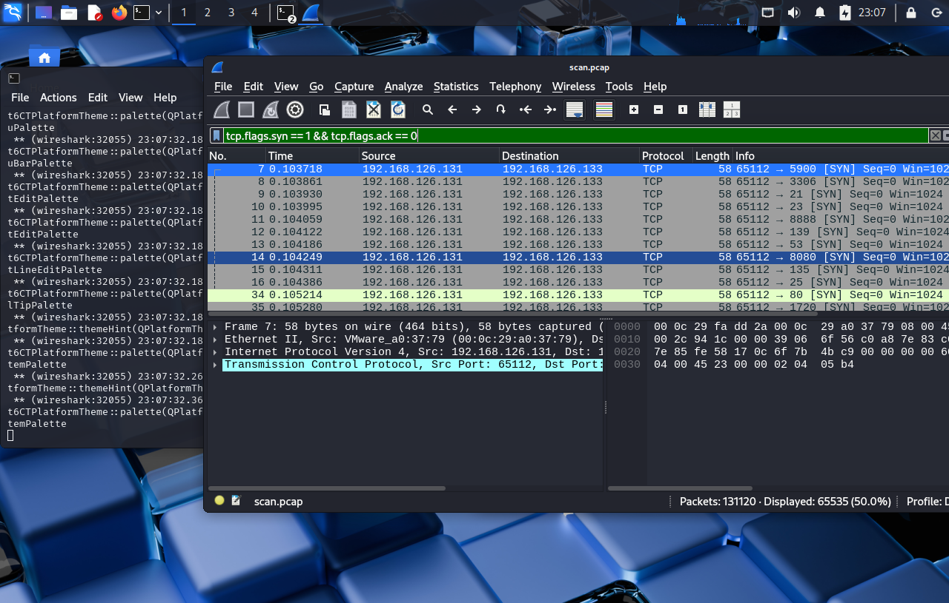
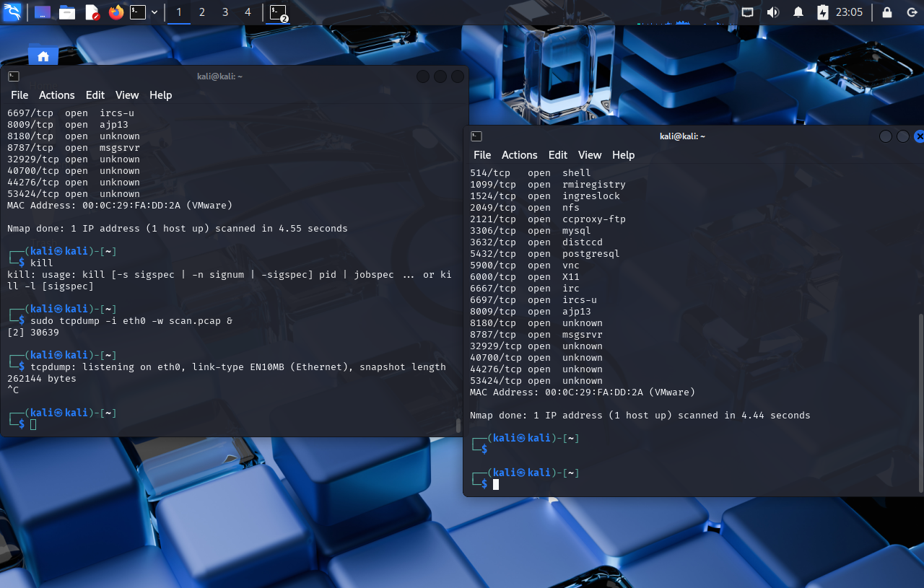
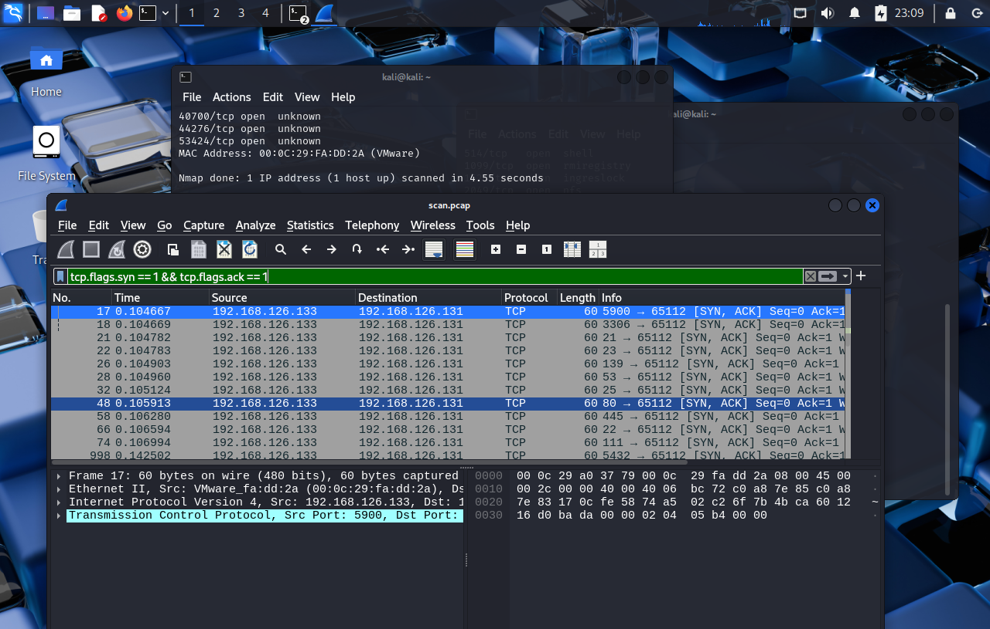
capture traffic Wireshark + tcpdump
sudo tcpdump -i eth0 -w scan.pcap
sudo nmap -sS -p- 192.168.126.133
tcp.flags.syn==1 && tcp.flags.ack==0
http.request.method=="POST

Slide 2
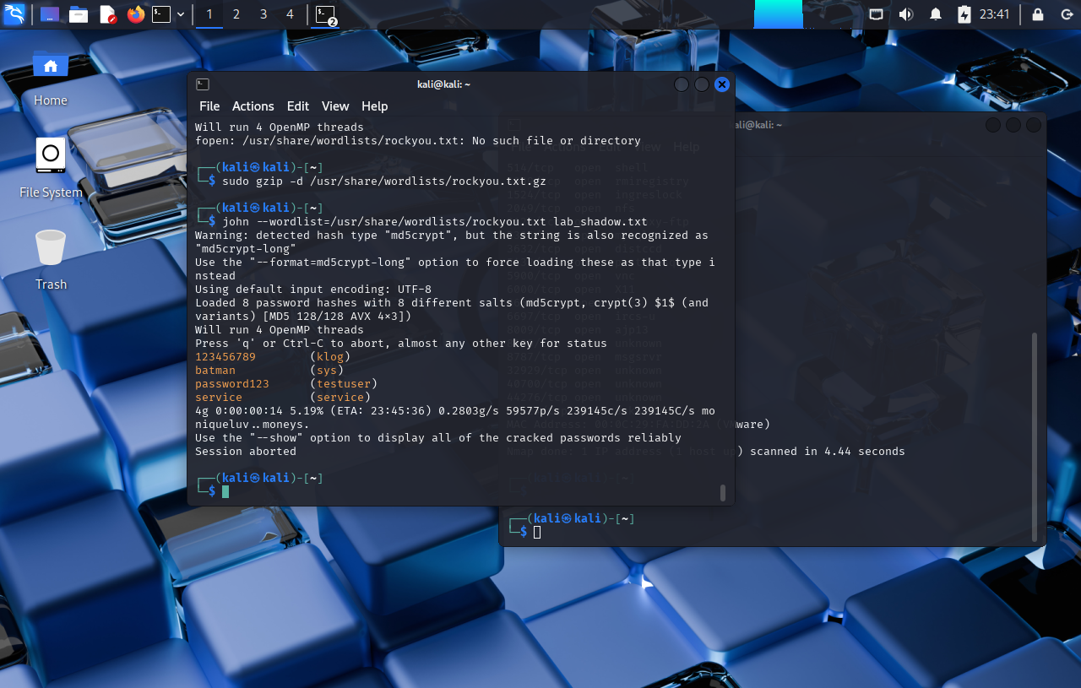
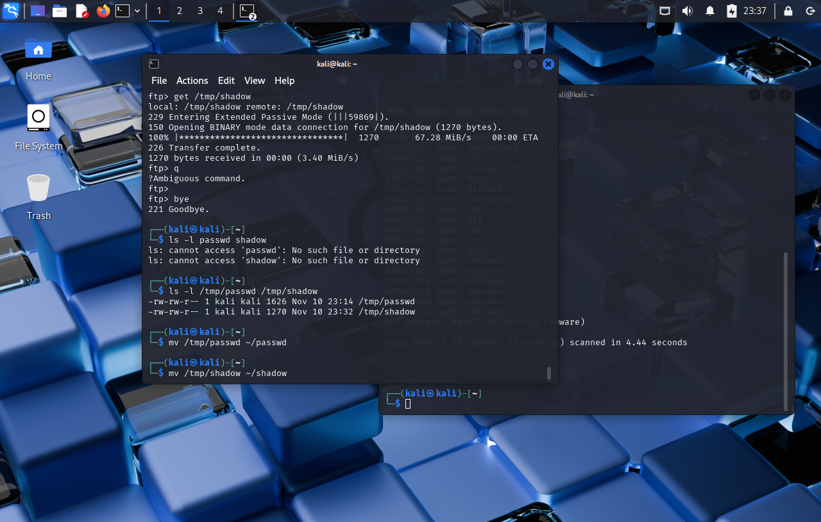
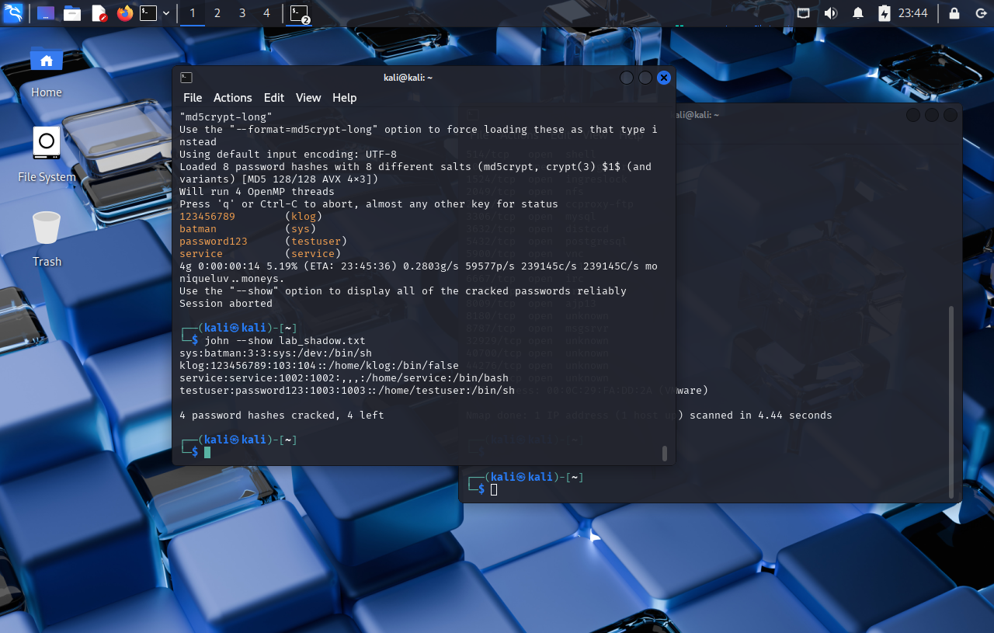
Password cracking John the Ripper
get shadow(hash) and passwd(username)
john --wordlist=/usr/share/wordlists/rockyou.txt lab_shadow.txt
unshadow passwd shadow > lab_shadow.txt combine
john --show lab_shadow.txt

